Slide 1
Recommender Systems
Jaya Sil

Slide 2
Introduction
With the rise of YouTube, Amazon, Netflix and many other such web services, recommender systems are today unavoidable in our daily online journeys.
Recommender systems are algorithms aimed at suggesting relevant items to users.
Two major paradigms of recommender systems : collaborative and content based methods.
Collaborative methods calculate similarity from interactions and Content based methods are based on similarity of item attributes.

Slide 3
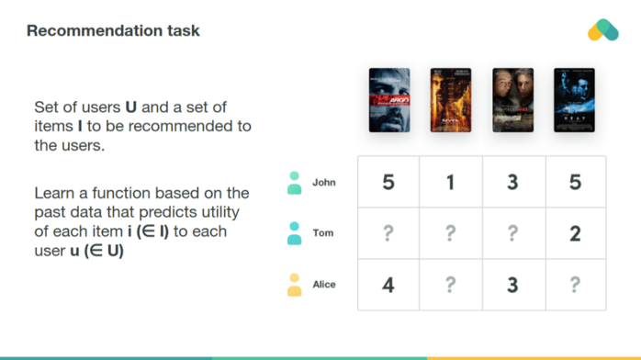
Collaborative methods

Slide 4
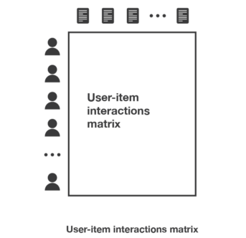
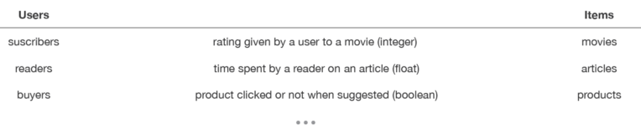
Collaborative methods
Based solely on the past interactions recorded between users and items in order to produce new recommendations.
These interactions are stored in the so-called “user-item interactions matrix”.
The main idea that rules collaborative methods is that the past user-item interactions are sufficient to detect similar users and/or similar items and make predictions based on these estimated proximities.

Slide 5
Collaborative methods
Collaborative methods work with the interaction matrix that can also be called rating matrix.
In the rare case when users provide explicit rating of items.
The task of machine learning is to learn a function that predicts utility of items to each user.
Matrix is typically huge, very sparse and most of values are missing.

Slide 6
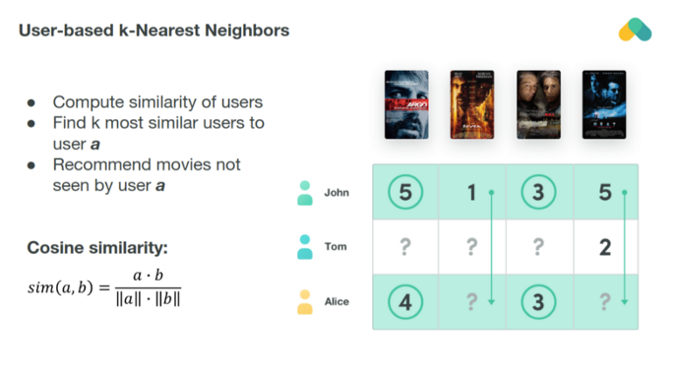
The simplest algorithm computes cosine or correlation similarity of rows (users) or columns (items) and recommends items that k — nearest neighbors enjoyed.

Slide 7
Collaborative methods
Collaborative algorithms is divided into (i) memory based and (ii) model based approaches.
Memory based approaches directly works with the values of recorded interactions, and based on nearest neighbours search.
Model based approaches assume an underlying “generative” model [p(x,y)] that explains the user-item interactions and try to discover it in order to make new predictions.
Generative modeling automatically discover and learning the patterns in input data in such a way that the model can be used to generate or output new examples

Slide 8
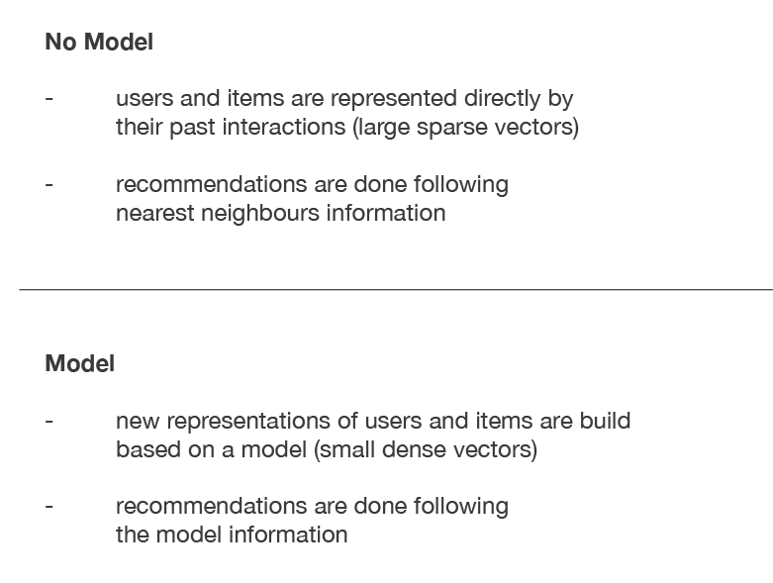
Collaborative filtering methods

Slide 9
Models, bias and variance
In memory based collaborative methods, no latent model is assumed.
As no latent model is assumed, these methods have theoretically a low bias but a high variance (Complex model).
In model based collaborative methods, some latent interaction model is assumed.
The model is trained to reconstruct user-item interactions values from its own representation of users and items.
New suggestions can then be done based on this model.

Slide 10
Models, bias and variance
The users and items latent representations extracted by the model have a mathematical meaning that can be hard to interpret for a human being.
So as a free model for user-item interactions is assumed has theoretically a higher bias but a lower variance than methods assuming no latent model.
However, as for model based collaborative methods, a user-item interactions model is assumed.
This model is more constrained (because representation of users and/or items are given) and, so, the method tends to have the highest bias but the lowest variance.
For example, users are represented by given features and we try to model for each item the kind of user profile that likes or not this item.

Slide 11
Advantage of collaborative Approaches
The main advantage of collaborative approaches is that they require no information about users or items and, so, they can be used in many situations.
The more users interact with items the more new recommendations become accurate.
For a fixed set of users and items, new interactions are recorded over time that bring new information and make the system more and more effective.
However, as it only consider past interactions to make recommendations, collaborative filtering suffer from the “cold start problem”.

Slide 12
Cold start problem
Each time a new ad is placed on your site, it goes through the cold start phase due to the lack of valuable user interactions.
User actions are incredibly important since these determine the future of both product-to-product and personalized, user-history-based recommendations.
This drawback can be addressed in different way: recommending random items to new users or new items to random users (random strategy).
Recommending popular items to new users or new items to most active users.
Recommending a set of various items to new users or a new item to a set of various users (exploratory strategy).

Slide 13
Memory based collaborative approaches- User-user
In order to make a new recommendation to a user, user-user method roughly tries to identify users with the most similar “interactions profile” (nearest neighbours) in order to suggest items that are the most popular among these neighbours (and that are “new” to our user).
This method is said to be “user-centred” as it represent users based on their interactions with items and evaluate distances between users

Slide 14
To make a recommendation for a given user
First, every user can be represented by its vector of interactions with the different items (“its line” in the interaction matrix).
Then, we can compute some kind of “similarity” between our user of interest and every other users, which measure closeness between two users with similar interactions on the same items.
Once similarities to every users have been computed, we can keep the k-nearest-neighbours to our user and then suggest the most popular items among them (only looking at the items that our reference user has not interacted with yet).

Slide 15
Computing similarity
When computing similarity between users, the number of “common interactions” (how much items have already been considered by both users?) should be considered carefully!
Avoid that someone that only have one interaction in common with our reference user could have a 100% match and be considered as being “closer” than someone having 100 common interactions and agreeing “only” on 98% of them.
So, we consider that two users are similar if they have interacted with a lot of common items in the same way (similar rating, similar time hovering…).

Slide 16
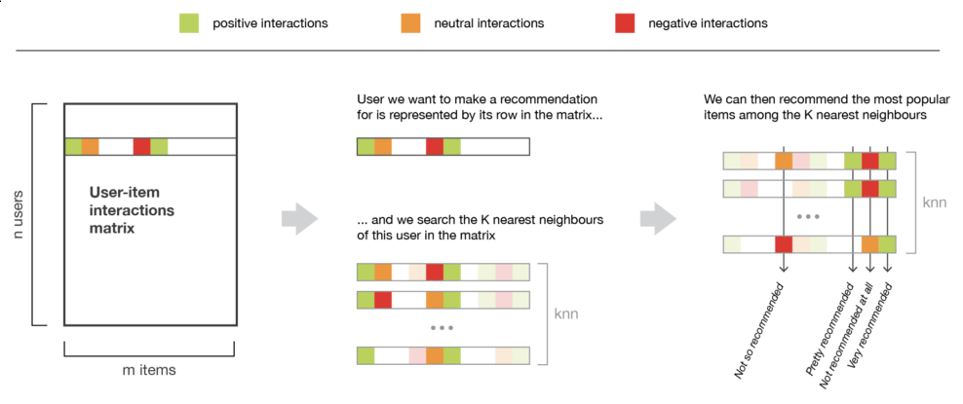
Memory based collaborative approaches- user-user

Slide 17
Memory based collaborative approaches- item-item
To make a new recommendation to a user, the idea of item-item method is to find the items similar to the ones the user already “positively” interacted with.
Two items are considered to be similar if most of the users that have interacted with both of them did it in a similar way.
This method is said to be “item-centred” as it represent items based on interactions users had with them and evaluate distances between those items.

Slide 18
To make a recommendation for a given user
First, we consider the item this user liked the most and represent it (as all the other items) by its vector of interaction with every users (“its column” in the interaction matrix).
Then, we can compute similarities between the “best item” and all the other items.
Once the similarities have been computed, we can then keep the k-nearest-neighbours to the selected “best item” that are new to our user of interest and recommend these items.
Notice that in order to get more relevant recommendations, we can do this job for more than only the user’s favourite item and consider the n preferred items instead.
In this case, we can recommend items that are close to several of these preferred items.

Slide 19
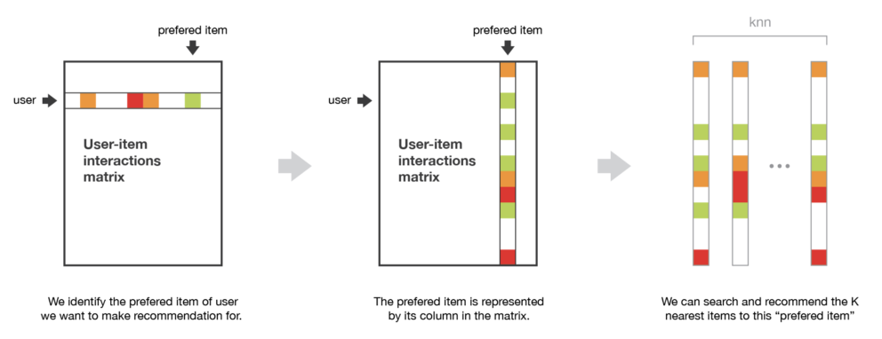
Memory based collaborative approaches- Item-item

Slide 20
Comparing user-user and item-item
The user-user method is based on the search of similar users in terms of interactions with items.
As, in general, every user have only interacted with a few items, it makes the method sensitive to any recorded interactions (high variance).
On the other hand, as the final recommendation is only based on interactions recorded for users similar to our user of interest, we obtain more personalized results (low bias).

Slide 21
Comparing user-user and item-item
Conversely, the item-item method is based on the search of similar items in terms of user-item interactions.
As, in general, a lot of users have interacted with an item, the neighbourhood search is far less sensitive to single interactions (lower variance).
As a counterpart, interactions coming from every kind of users (even users very different from our reference user) are then considered in the recommendation, making the method less personalised (more biased) than the user-user approach but more robust.

Slide 22
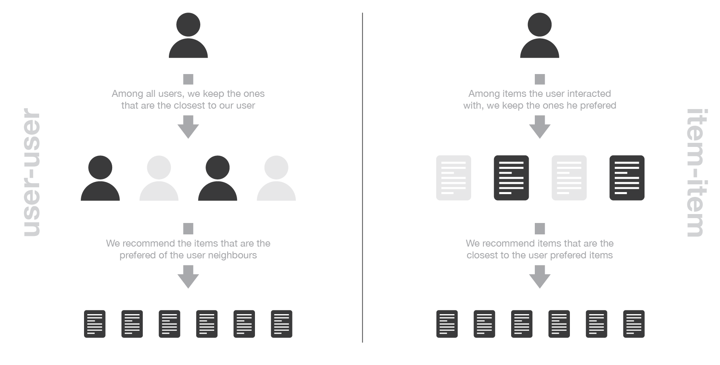

Slide 23
Complexity
One of the biggest flaw of memory based collaborative filtering is that they do not scale easily.
Generating a new recommendation can be extremely time consuming for big systems, say with millions of users and millions of items.
The nearest neighbours search step can become intractable if not carefully designed (KNN algorithm has a complexity of O(ndk) with n the number of users, d the number of items and k the number of considered neighbours).
In order to make computations more tractable for huge systems, we can both take advantage of the sparsity of the interaction matrix when designing our algorithm or use approximate nearest neighbours methods (ANN).

Slide 24
Effects
In most of the recommendation algorithms, it is necessary to be extremely careful to avoid a “rich-get-richer” effect for popular items and to avoid getting users stuck into what could be called an “information confinement area”.
In other words, we do not want that our system tend to recommend more and more only popular items as well as we do not want that our users only receive recommendations for items extremely close to the one they already liked with no chance to get to know new items they might like too.
These problems can arise in most of the recommendation algorithms, especially true for memory based collaborative ones.

Slide 25
Model based collaborative approaches
Model based collaborative approaches only rely on user-item interactions information and assume a latent model supposed to explain these interactions.
For example, matrix factorization algorithms consists in decomposing the huge and sparse user-item interaction matrix into a product of two smaller and dense matrices: a user-factor matrix (containing users' representations) that multiplies a factor-item matrix (containing items representations).

Slide 26
Content based methods
Unlike collaborative methods that only rely on the user-item interactions, content-based approaches use additional information about users and/or items.
If we consider the example of a movies recommender system, this additional information can be, the age, the job or any other personal information for users as well as the category, the main actors, the duration (items).
The idea of content-based methods is to try to build a model, based on the available “features”, that explain the observed user-item interactions.

Slide 27
Content based methods
Making new predictions for a user is easier if we obtain a model.
We just need to look at the profile (age, sex, …) of this user and, based on this information, to determine relevant movies to suggest.
Content based methods suffer far less from the cold start problem than collaborative approaches: new users or items can be described by their characteristics (content) and so relevant suggestions can be done for these new entities.
Only new users or items with previously unseen features will logically suffer from this drawback, but once the system old enough, this has few to no chance to happen.

Slide 28
Content based approaches
In content-based methods, the recommendation problem is casted into either a classification problem (predict if a user “likes” or not an item) or into a regression problem (predict the rating given by a user to an item).
In both cases, we are going to set a model that will be based on the user and/or item features at our disposal (the “content” of our “content-based” method).
If our classification (or regression) is based on users features, we say the approach is item-centred: modelling, optimisations and computations can be done “by item”.

Slide 29
Item Centered
In this case, we build and learn one model by item based on users features trying to answer the question “what is the probability for each user to like this item?”
Or “what is the rate given by each user to this item?”, for regression.
The model is robust as a lot of users have interacted with the item.
However, the interactions considered to learn the model come from every users and even if these users have similar characteristic (features) their preferences can be different.
This mean that even if this method is more robust, it can be considered as being less personalized (more biased).

Slide 30
user-centered
If we work with items features, the method is then user-centered: modelling, optimizations and computations can be done “by user”.
We then train one model by user based on items features that tries to answer the question “what is the probability for this user to like each item?” (or “what is the rate given by this user to each item?”, for regression).
We can then attach a model to each user that is trained on its data: the model obtained is, so, more personalized than its item-centered counterpart as it only considers interactions from the considered user.
However, most of the time a user has interacted with relatively few items and, so, the model we obtain is a far less robust than an item-centered one.

Slide 31
Matrix factorization
The main assumption behind matrix factorization is that there exists a low dimensional latent space of features in which we can represent both users and items and such that the interaction between a user and an item can be obtained by computing the dot product of corresponding dense vectors in that space.
For example, consider that we have a user-movie rating matrix.
In order to model the interactions between users and movies, we can assume that: there exists some features describing (and telling apart) pretty well movies.
These features can also be used to describe user preferences (high values for features the user likes, low values otherwise)

Slide 32
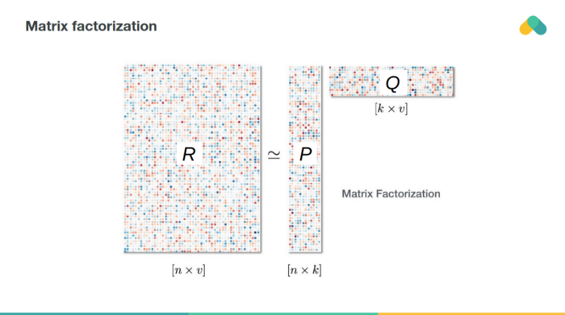
Matrix factorization-based methods attempt to reduce dimensionality of the interaction matrix and approximate it by two or more small matrices with k latent components.

Slide 33
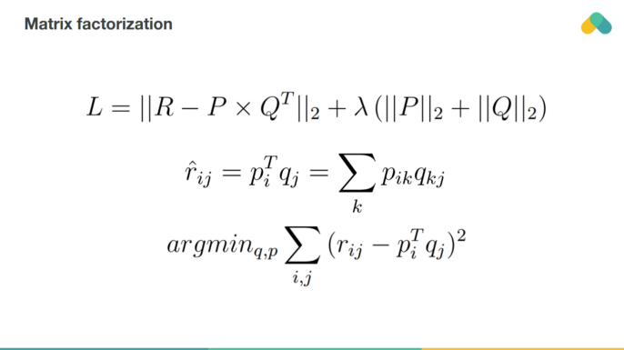
By multiplying corresponding row and column you predict rating of item by user.
Training error can be obtained by comparing nonempty ratings to predicted ratings.
One can also regularize training loss by adding a penalty term keeping values of latent vectors low.

Slide 34
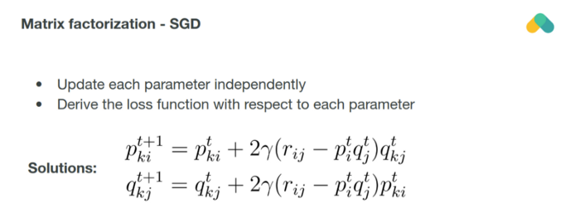
Most popular training algorithm is a stochastic gradient descent minimizing loss by gradient updates of both columns and rows of p a q matrices.

Slide 35
Matrix Factorization
Once the matrix has been factorized, we have less information to manipulate in order to make a new recommendation.
We can simply multiply a user vector by any item vector in order to estimate the corresponding rating.
Notice that we could also use user-user and item-item methods with these new representations of users and items.
Nearest neighbors searches wouldn’t be done over huge sparse vectors but over small dense ones making some approximation techniques more tractable.

